Slide 1
Smart Traffic Light System Using Ultrasonic Sensors
MICROPROCESSORS PROJECT

Slide 2
Group 1
Group Members:
MENSAH YOAN ANGENOR A.
ACQUAH IVAN MANTE
CHRISTOPH KOFIE DADE
OWUSU DANIEL TIMOTHY
TUTU OPHILIA

Slide 3
Table of Content
Problem Statement
Methodology – Approach and Code Breakdown
Demonstration/Simulation
Conclusion

Slide 4
Problem Statement
Traditional traffic lights operate on fixed timers, causing inefficiencies like traffic congestion, wasted time, fuel consumption, and environmental pollution. They fail to adapt to real-time traffic conditions, leading to longer wait times and poor traffic flow.
The smart traffic light system solves this by using ultrasonic sensors to detect vehicle density in real-time and adjust signals accordingly. This optimizes traffic flow, reduces delays, lowers emissions, and improves overall road efficiency.

Slide 5
Methodology
Before taking a look at the methodology of the system, let’s familiarize ourselves with the components of the system and their functions.
Components and Their Functions
1. Arduino Uno
Role: Acts as the brain of the system.
Function: Controls the flow of traffic lights and receives distance input from ultrasonic sensors to decide which traffic lane gets the green light.

Slide 6
2. LEDs (Light Emitting Diodes)
Types: Red, Yellow, Green (2 sets → representing 2 roads)
Function: Simulate traffic lights for two intersecting roads.
Red: Stop signal
Yellow: Get ready
Green: Go

Slide 7
3. Resistors
Function: Current limiting for the LEDs to prevent burning them out.
Typical Value: 1000Ω

Slide 8
4. Ultrasonic Sensors (HC-SR04)
Quantity: 2 (one for each road)
Pins: 4
VCC: Power supply (connected to 5V)
GND: Ground
Trig: Trigger pin (sends ultrasonic pulse)

Slide 9
Echo: Echo pin (receives reflected pulse)
Function: Detect the presence and count of vehicles waiting at each road. Distance-based detection helps decide priority (which road has more waiting cars).

Slide 10
5. Breadboard
Function: Allows easy prototyping and connecting of components. Distributes power and connects resistors and LEDs to the Arduino.

Slide 11
6. Jumper Wires
Function: Interconnect components like Arduino, LEDs, resistors, and sensors.

Slide 12
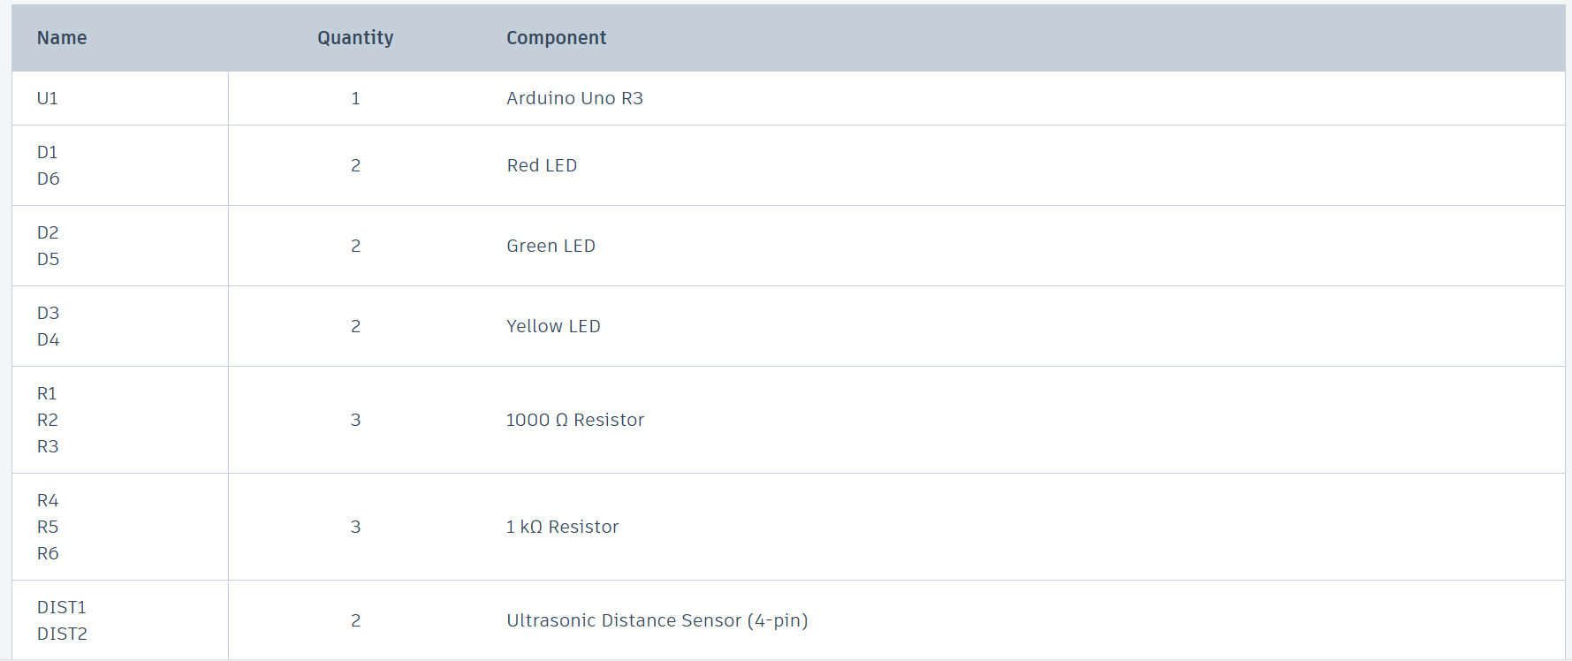

Slide 13
Approach Taken to Solve the Problem
This system uses real-time sensor input + conditional logic on Arduino to dynamically control traffic lights at a junction, prioritizing roads with more traffic and minimizing idle time—effectively reducing congestion and improving flow efficiency.

Slide 14
Below is a pictorial representation of the circuitry of the Smart Traffic System.

Slide 15
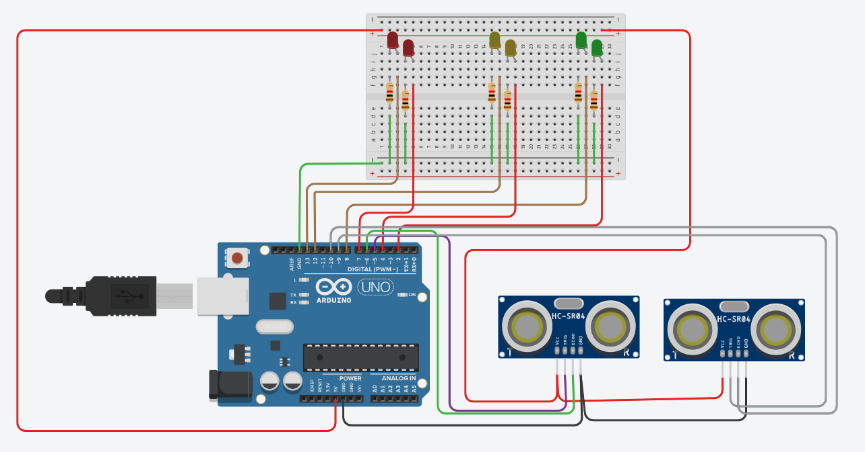

Slide 16
Working Principle
Ultrasonic sensors measure the distance to detect cars.
Arduino Uno reads these distances and compares them.
Based on traffic density, it:
Gives green light to the road with more cars.
Keeps red on the less busy road.

Slide 17
Transitions using yellow (short delay).
Repeats this cycle intelligently to reduce wait time and avoid congestion.

Slide 18
Code and Schematics Overview
As we delve into the code behind this system, lets take a look at the schematic diagram of the circuit the system is made of.

Slide 19
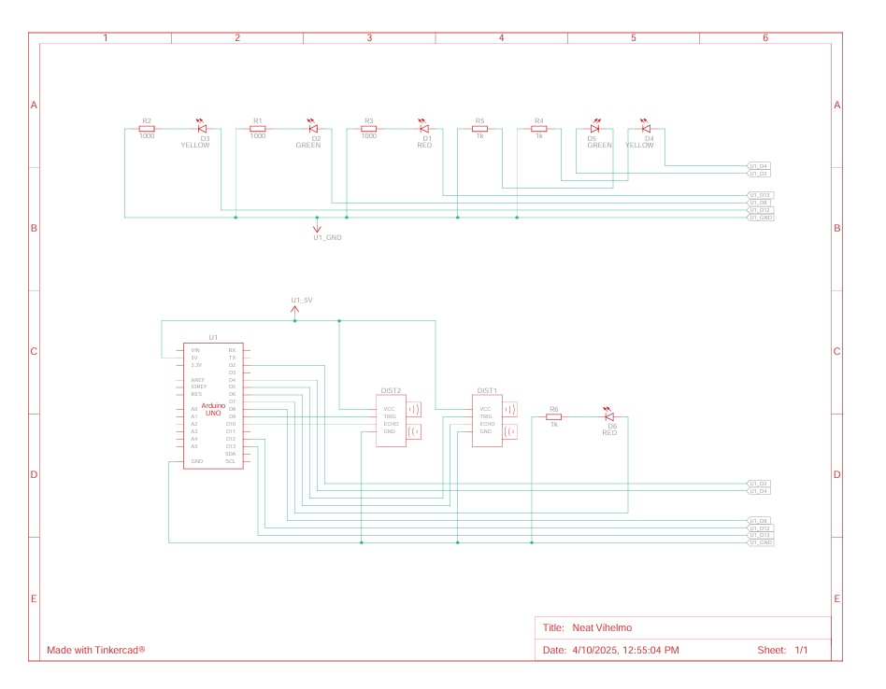
Schematic

Slide 20
CODE
The system runs on an extensive block of code. In this unit we are going to break down the code and explain it step by step

Slide 21
// Lane 1 Traffic Lights
#define RED1 13
#define YELLOW1 12
#define GREEN1 8
// Lane 1 Ultrasonic Sensor
#define TRIG1 5
#define ECHO1 6
// Lane 2 Traffic Lights
#define RED2 7
#define YELLOW2 4
#define GREEN2 2
// Lane 2 Ultrasonic Sensor
#define TRIG2 9
#define ECHO2 10

Slide 22
void setup() {
// Set up pins for LEDs
pinMode(RED1, OUTPUT);
pinMode(YELLOW1, OUTPUT);
pinMode(GREEN1, OUTPUT);
pinMode(RED2, OUTPUT);
pinMode(YELLOW2, OUTPUT);
pinMode(GREEN2, OUTPUT);
// Set up pins for ultrasonic sensors
pinMode(TRIG1, OUTPUT);
pinMode(ECHO1, INPUT);
pinMode(TRIG2, OUTPUT);
pinMode(ECHO2, INPUT);
Serial.begin(9600);
}

Slide 23
// Function to measure distance using ultrasonic sensor
long getDistance(int trigPin, int echoPin) {
digitalWrite(trigPin, LOW);
delayMicroseconds(2);
digitalWrite(trigPin, HIGH);
delayMicroseconds(10);
digitalWrite(trigPin, LOW);
long duration = pulseIn(echoPin, HIGH);
long distance = duration * 0.034 / 2; // Convert to cm
return distance;
}

Slide 24
// Function to handle lane switching with correct delays
void switchLane(int red1, int yellow1, int green1, int red2, int yellow2, int green2) {
// Step 1: Red Light ON for 7 sec before switching lanes
digitalWrite(red1, HIGH);
digitalWrite(green1, LOW);
digitalWrite(yellow1, LOW);
digitalWrite(red2, HIGH);
digitalWrite(green2, LOW);
digitalWrite(yellow2, LOW);
delay(7000); // Red delay

Slide 25
// Step 2: Yellow Light for 2 sec
digitalWrite(red1, LOW);
digitalWrite(yellow1, HIGH);
delay(2000); // Yellow delay
digitalWrite(yellow1, LOW);
digitalWrite(green1, HIGH);
delay(8000); // Green delay
// Step 4: Turn off Green, Prepare to switch
digitalWrite(green1, LOW);
digitalWrite(yellow1, HIGH);
delay(2000); // Yellow before switching

Slide 26
// Switch to next lane
digitalWrite(yellow1, LOW);
digitalWrite(red1, HIGH);
digitalWrite(red2, LOW);
digitalWrite(yellow2, HIGH);
delay(2000); // Yellow transition
digitalWrite(yellow2, LOW);
digitalWrite(green2, HIGH);
delay(8000); // Green delay for second lane

Slide 27
digitalWrite(green2, LOW);
digitalWrite(yellow2, HIGH);
delay(2000); // Yellow before switching back
digitalWrite(yellow2, LOW);
digitalWrite(red2, HIGH);
}
// Main loop to check traffic and control lights
void loop() {
long distance1 = getDistance(TRIG1, ECHO1);
long distance2 = getDistance(TRIG2, ECHO2);

Slide 28
Serial.print("Lane 1 Distance: ");
Serial.print(distance1);
Serial.print(" cm | Lane 2 Distance: ");
Serial.println(distance2);

Slide 29
if (distance1 < 20 && distance2 >= 20) {
// Vehicles detected in Lane 1, but not in Lane 2
switchLane(RED1, YELLOW1, GREEN1, RED2, YELLOW2, GREEN2);
} else if (distance2 < 20 && distance1 >= 20) {
// Vehicles detected in Lane 2, but not in Lane 1
switchLane(RED2, YELLOW2, GREEN2, RED1, YELLOW1, GREEN1);
} else if (distance1 < 20 && distance2 < 20) {
// Vehicles detected in both lanes, follow normal switching
switchLane(RED1, YELLOW1, GREEN1, RED2, YELLOW2, GREEN2);
} else {
// No vehicles detected, default cycle
switchLane(RED1, YELLOW1, GREEN1, RED2, YELLOW2, GREEN2);
}

Slide 30
delay(500); // Small delay before next detection
}

Slide 31
Code Breakdown and Explanation

Slide 32
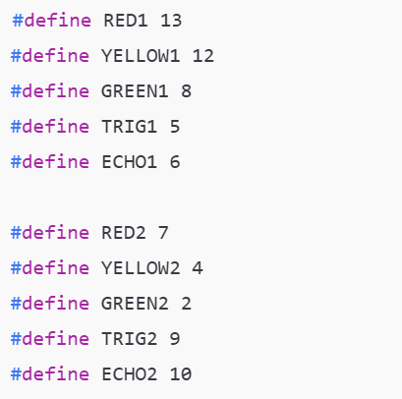
DEFINING PINHOLES
We’re using #define to give names to the pins for clarity.
RED1, YELLOW1, GREEN1 are the LEDs for Lane 1 (controlled by digital pins).
TRIG1 and ECHO1 are the trigger and echo pins of the ultrasonic sensor for Lane 1.
Same goes for RED2, YELLOW2, GREEN2, TRIG2, ECHO2 for Lane 2.
This makes the code easy to read and maintain.

Slide 33
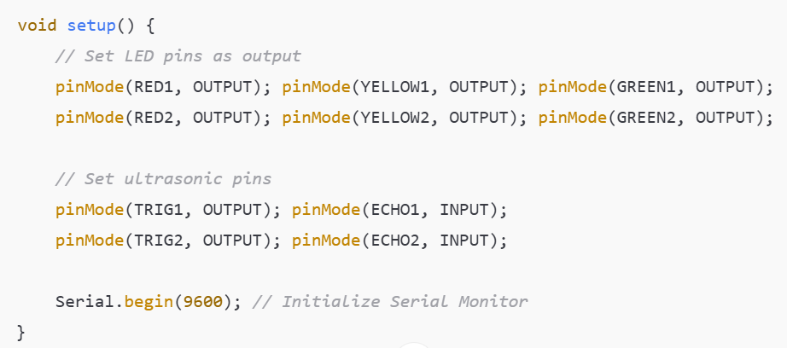
STEP FUNCTION
pinMode() configures each pin as input/output.
The Serial.begin(9600) line starts the serial communication at 9600 baud rate so you can monitor sensor readings.

Slide 34
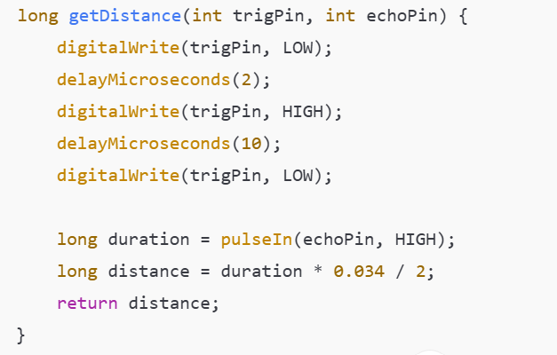
ULTRASONIC DISTANCE MEASURING FUNCTION
This function:
Sends a 10 µs pulse from the trigger pin.
Measures how long it takes for the echo to come back.
Converts that duration to distance in centimeters using the speed of sound (0.034 cm/µs).

Slide 35
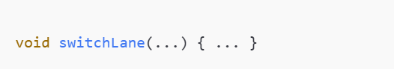
TRAFFIC LIGHT SWITCHING LOGIC
This is a comprehensive routine to:
Turn both lanes red to pause traffic for 7 seconds.
Turn yellow on one lane to prepare it.
Turn green on that lane for 8 seconds (traffic moves).
Yellow again before switching.
Switch to the next lane and repeat the same sequence.
It handles a complete cycle of light changes for both lanes safely.

Slide 36
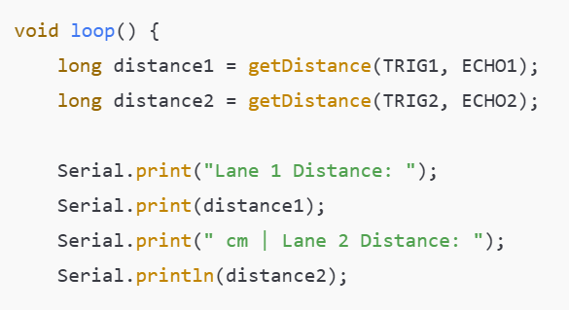
MAIN CONTROL LOGIC
Reads distances from both ultrasonic sensors.
Prints the values for debugging/monitoring.

Slide 37
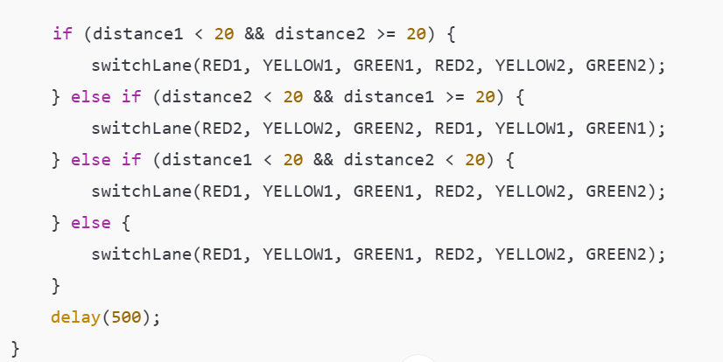
What this does:
If cars are detected in Lane 1 only, it gives priority to Lane 1.
If cars are detected in Lane 2 only, it gives priority to Lane 2.
If cars are in both lanes, or none, it uses the default cycle.
The check distance < 20 assumes anything within 20cm is a vehicle at the junction.

Slide 38
Cycle Summary
Every loop:
Sensor checks traffic presence.
Lights are changed accordingly.
Vehicles are allowed to pass based on traffic condition.

Slide 39
Demonstration/Simulation
Now, we’re going to run a simulation of the system to demonstarte te operation of the system

Slide 40
Conclusion
The smart traffic light system effectively addresses the limitations of traditional traffic signal operations by dynamically responding to real-time vehicle flow.
Key outcomes include:
Reduced traffic delays
Better fuel efficiency
Lower emissions
Smoother road usage

Slide 41
Possible improvements
Addition of a buzzer for pedestrian warning signals: Adding a buzzer for pedestrian warning signals in a smart traffic system improves safety and accessibility and helps maintain efficient traffic flow
Inclusion of a real-time clock (RTC) for time-based control (e.g., peak vs non-peak hours) : Including a Real-Time Clock (RTC) in a smart traffic system enables time-based adjustments, optimizing traffic flow by adapting light timings to peak and non-peak hours, prioritizing emergency vehicles, and adjusting for holidays or special events.

Slide 42
THANK YOU

